Slide 1
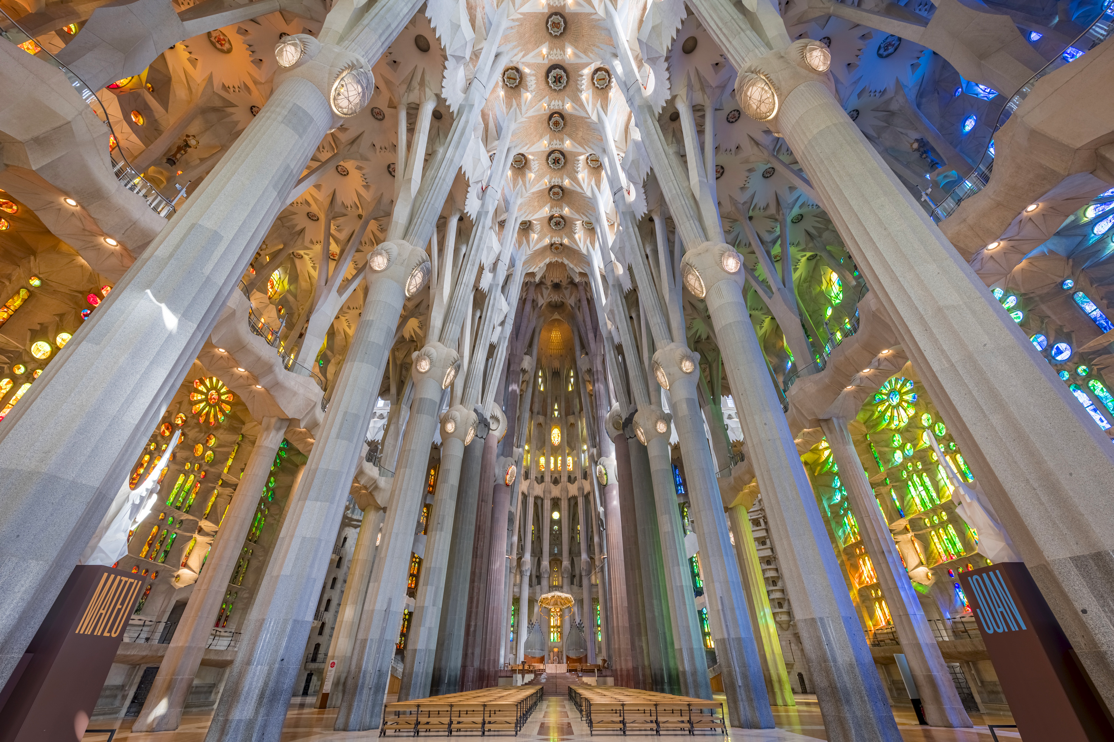
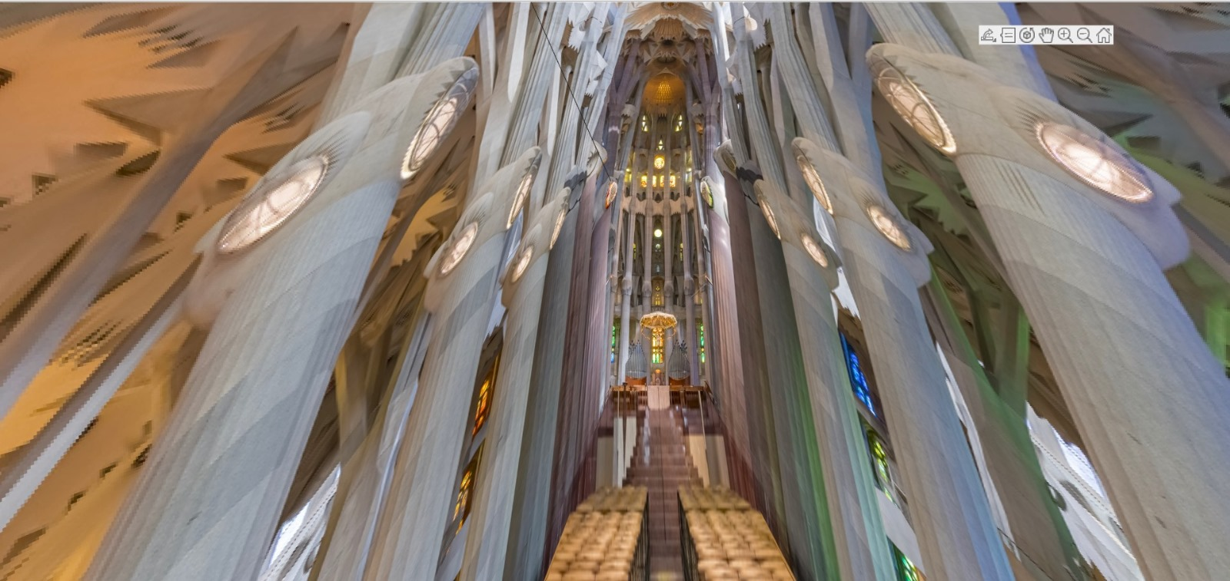
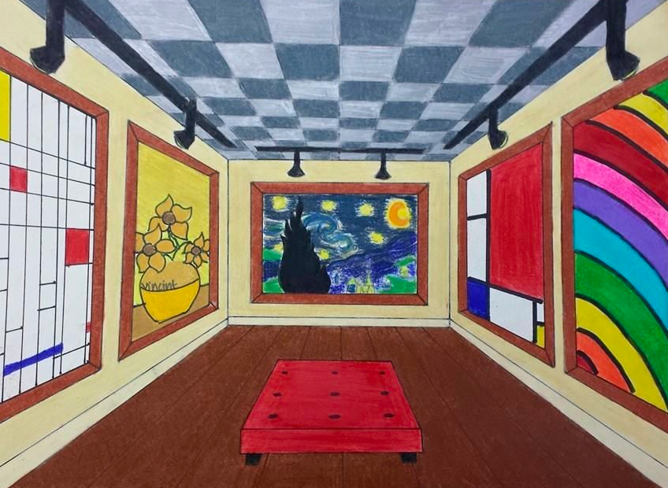
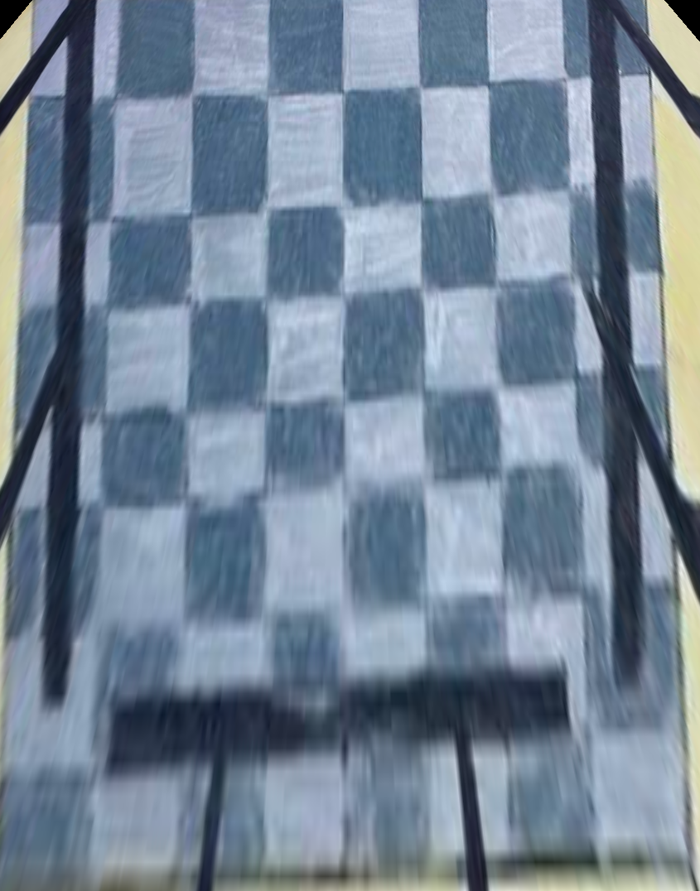
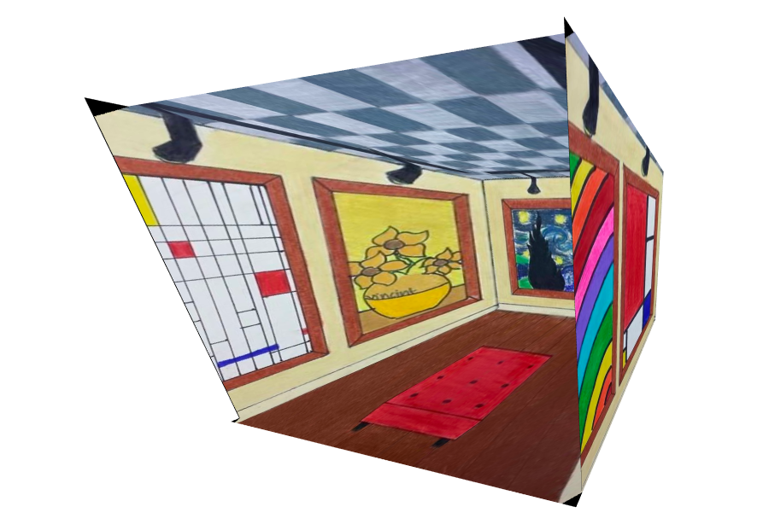
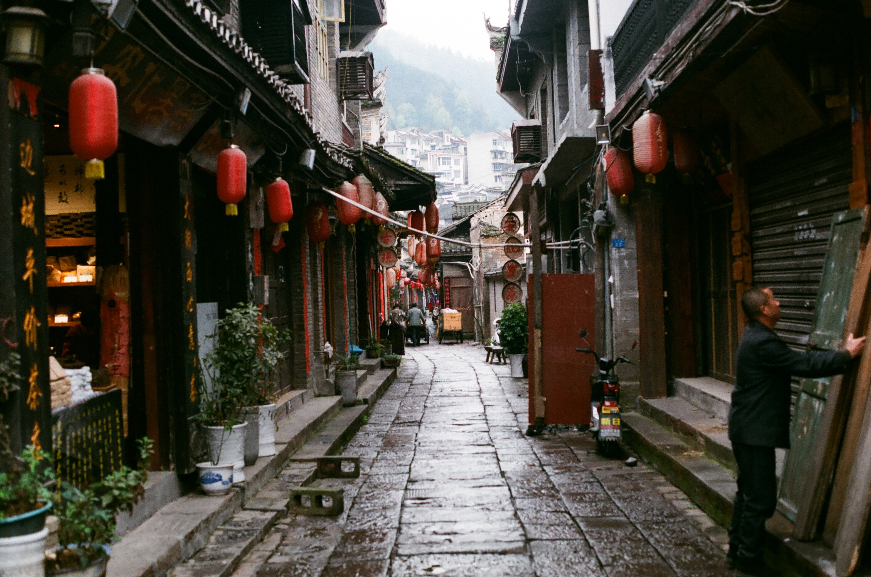
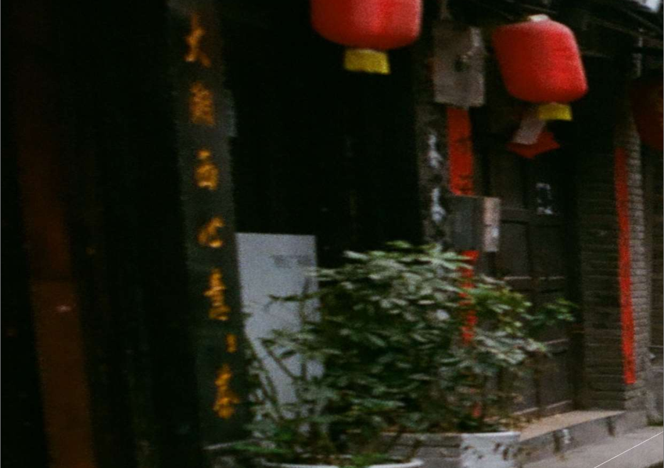
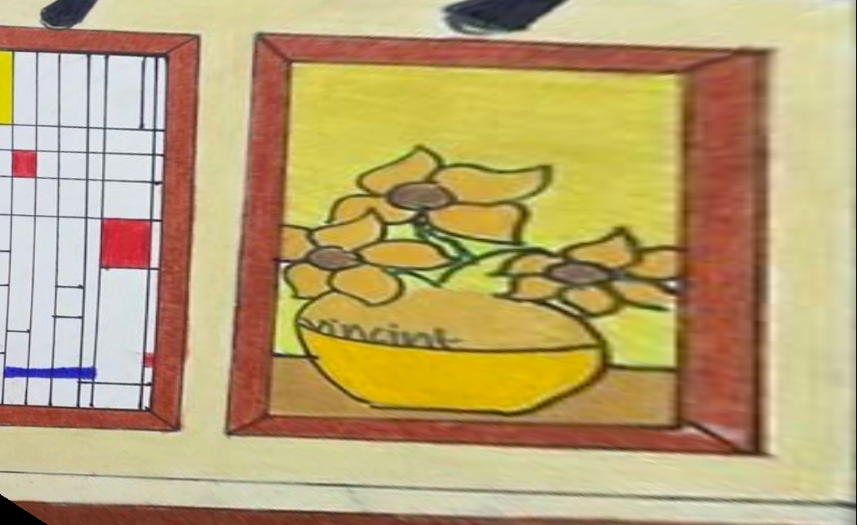
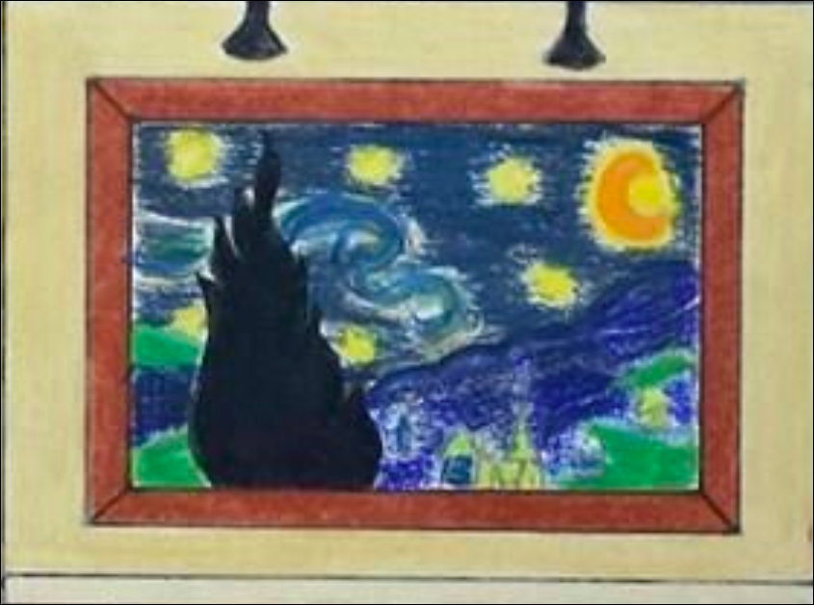
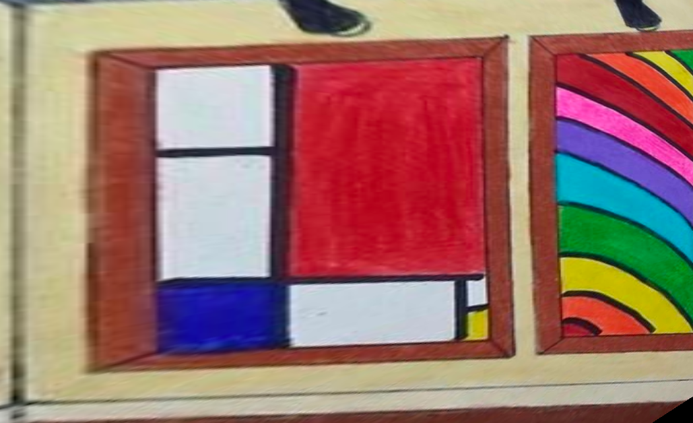
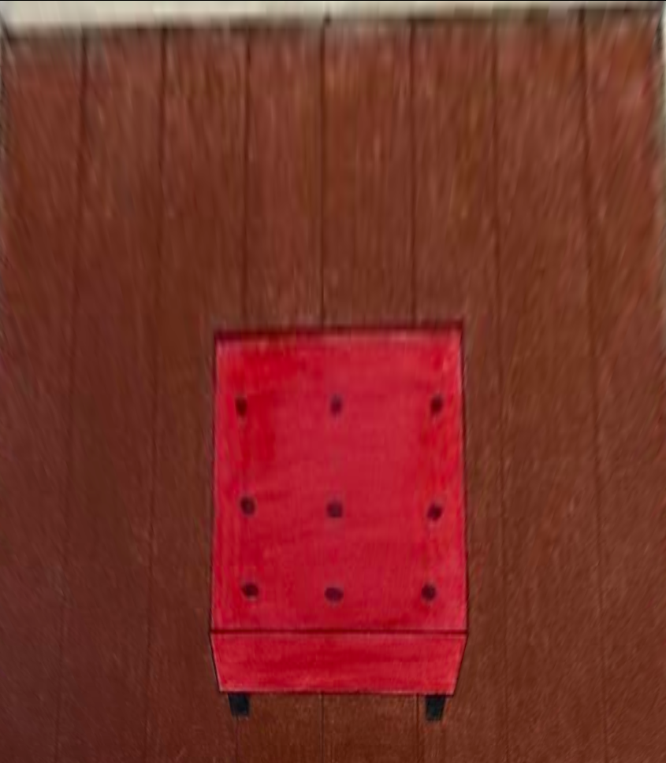
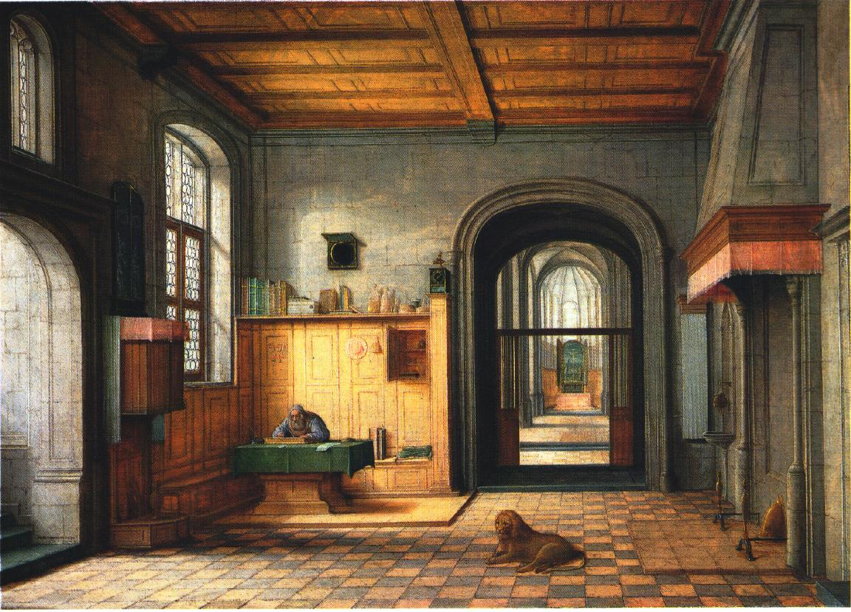



Computer Vision Challenge Tour into the Picture
Vincent Amberger – Yuan Fang – Adam Kadmani Haorui Long – Yao Lu – Van Dai Nguyen
1 Workflow
2 Animation
Input
Background Box
3D Scene
Animation
Start
User Inputs
Processing
Result
Game-like movement within the scene using the mouse and WASD keys, where the cursor direction determines the movement plane
App Initialization
Vanishing Point
Inner Rectangle
Foreground Object
Background Model
Foreground Model
Texture Mapping
Foreground Object
Animation
3 results
Background model
Box with 5 surfaces [1]
Geometry of vanishing point and vertices
Inverse perspective projection
Texture Mapping Find transformation:
$$J=f(I)$$
4 challenges
3D model for foreground objects
Scenes without clearly identifiable vanishing point
Implementation of the mouse movement
UI-Challenge: To give user explicit hints on workflow without too much text
Foreground model
A simple surface defined by a polygon [1]
α-value from foreground mask
$C=\left(1−α\right)C_{B}+αC_{F}$
5 Reference
[1] Horry, Youichi, Ken-Ichi Anjyo, and Kiyoshi Arai. "Tour into the picture: using a spidery mesh interface to make animation from a single image." Proceedings of the 24th annual conference on Computer graphics and interactive techniques. 1997.

